Slide 1


Lesson 9 The most interesting sea animals
UNIT 2

Slide 2
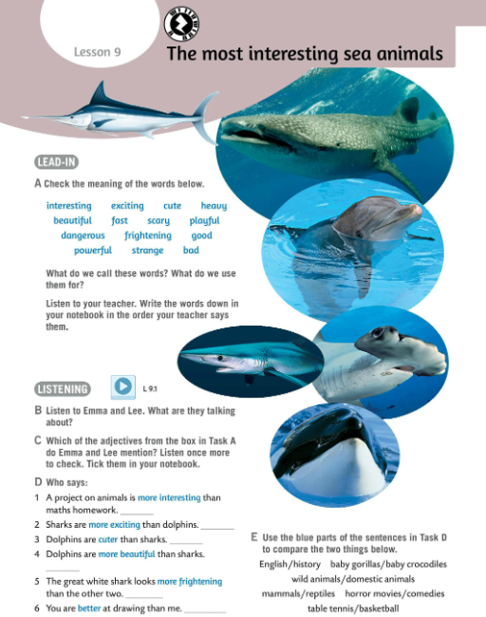
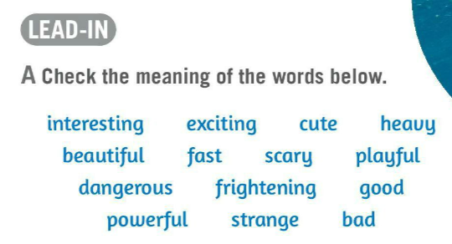
Check the meaning of the words in Task A. Write them down.
interesting – zanimljiv
exciting – uzbudljivo
cute – sladak
heavy – težak
beautiful – lijep
fast – brz
scary – jeziv, zastrašujući
playful – zaigran
dangerous – opasan
frightening – zastrašujuć
good – dobar
powerful – snažan
strange – neobičan
bad – loš, zao

Slide 3
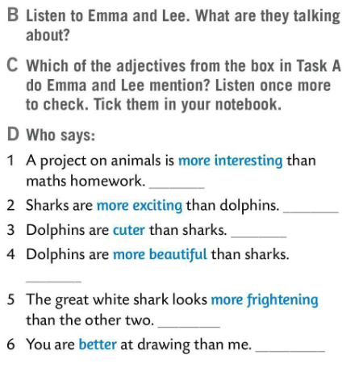

What do we call words in Task A?
Adjectives (pridjevi).
What do we use them for?
We use them to describe things.
Listen to Emma and Lee. What are they talking about? Listen.
Which of the adjectives from the box in Task A do Emma and Lee mention? Listen once again and tick them in your notebook.
Share your answer in class.

Slide 4
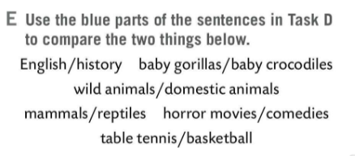
Who says sentences in Task D? Write the names.
Listen and check.
Use the blue parts of the sentences in Task D to compare the two things in Task E.
Emma
Lee
Emma
Emma
Check.
Lee
Possible answers:
English is more interesting than History. Baby gorillas are cuter than baby crocodiles. Wild animals are more frightening than domestic animals. Mammals are more exciting than reptiles. Horror movies are more frightening than comedies. Basketball is more exciting than table tennis.
Lee

Slide 5
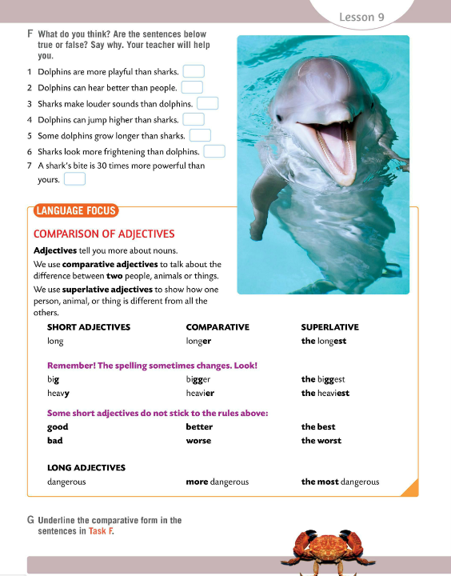
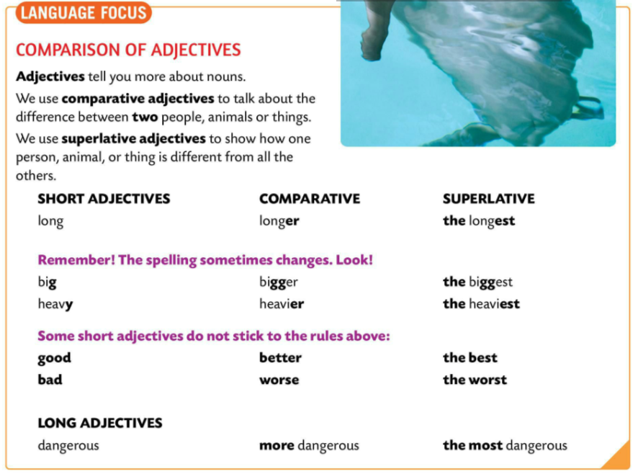
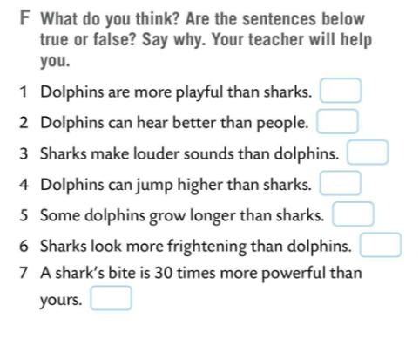
Do you know any facts about sharks or dolphins?
What do you think about sentences in Task F? Are the sentences true or false? Why.
LANGUAGE FOCUS
Adjectives are words which tell us more about nouns.
Pridjevi su riječi koje pobliže opisuju imenice.
We use the comparative form to talk about the difference between TWO people, animals, or things.
Komparativ koristimo kada želimo usporediti DVIJE osobe, životinje ili stvari.
We form comparative by adding –er at the end of an adjective.
Komparativ tvorimo tako što ćemo dodati nastavak –er na kraj pridjeva.
A horse is faster than a sheep.

Slide 6
LANGUAGE FOCUS
We use the superlative form to show how one person, animal, or thing is different from all the others.
Superlativ koristimo kada želimo istaknuti posebnost (usporediti) jedne osobe, životinje ili stvari u odnosu na cijelu skupinu.
We form superlative by adding article the at the beginning of the adjective and –est at the end of an adjective.
Superlativ tvorimo tako što ćemo dodati član the ispred pridjeva i nastavak –est na kraj pridjeva.
This car is the fastest.

Slide 7
Look at the examples.
Notice the spelling of the adjectives.
Copy comparative and superlative forms of the adjectives LONG, BIG AND, HEAVY.
Some short adjectives do not stick to the rules.
Copy them.

Slide 8
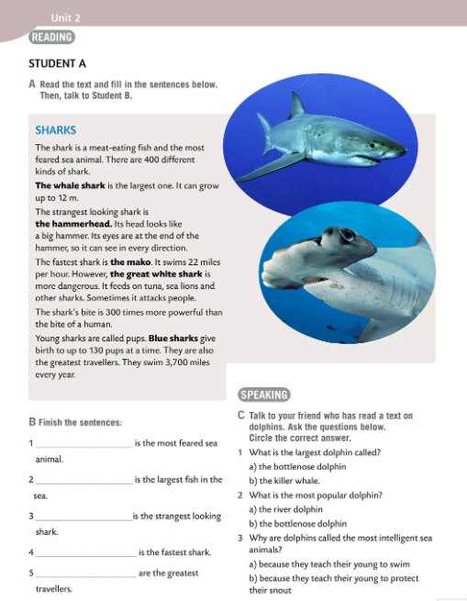
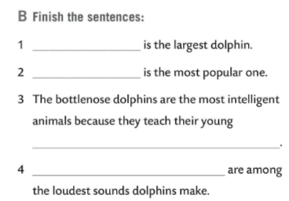
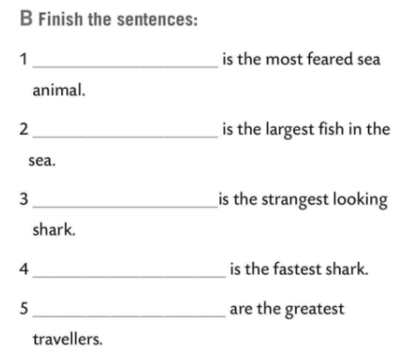
Work in pairs.
Student A reads the text about sharks.
Student B reads the text about dolphins.
After the reading talk to each other.
What did you learn?
The shark
The orca or the killer whale
The whale shark
The bottlenose dolphin
The hammerhead
how to protect their snout
The mako
Whistling and making clicks
Blue sharks
Fill in the sentences in Task B.
Check both tasks.

Slide 9

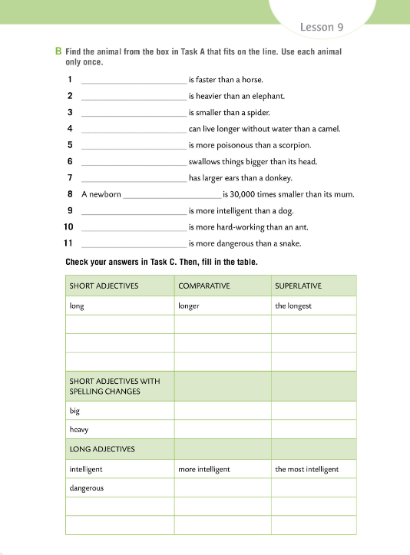
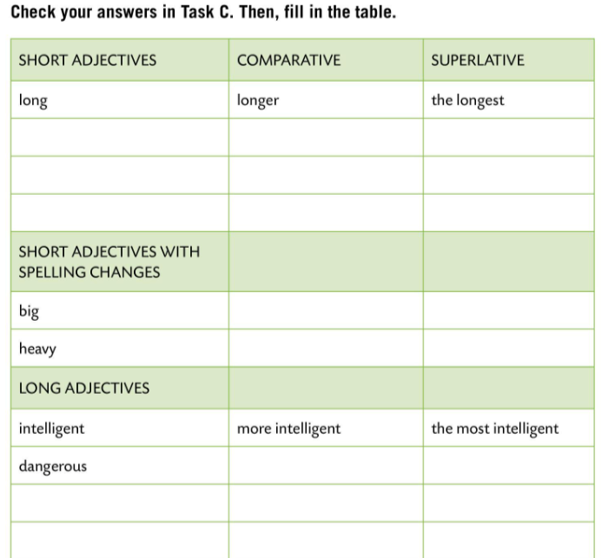
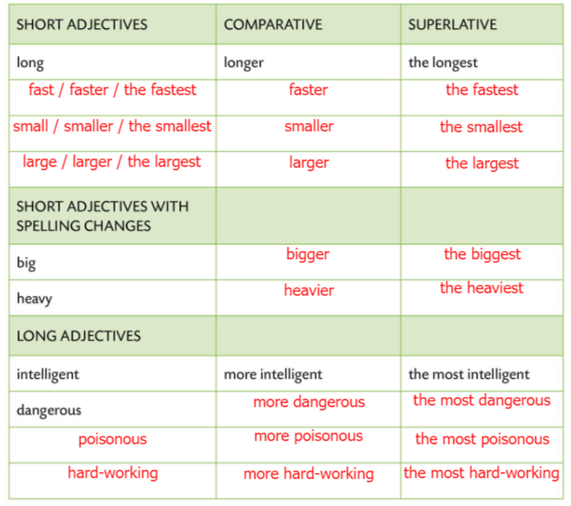
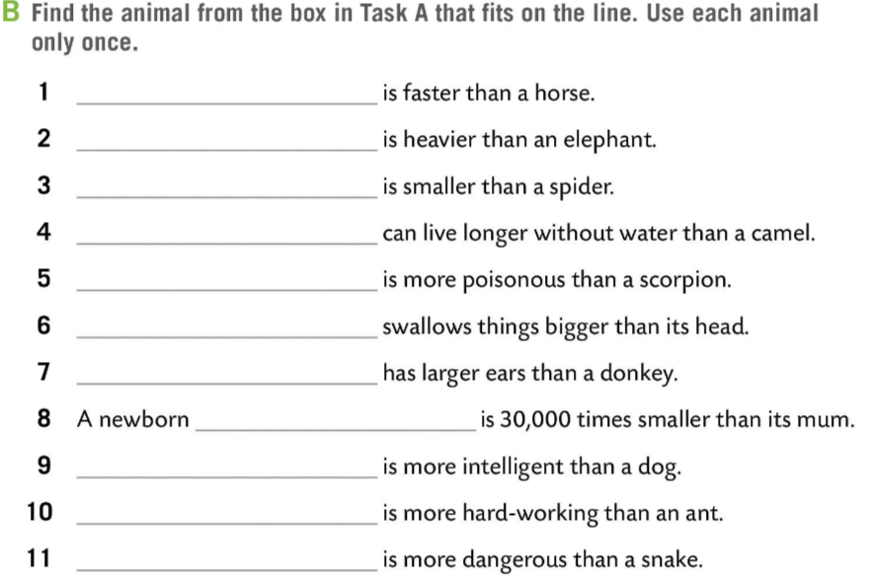
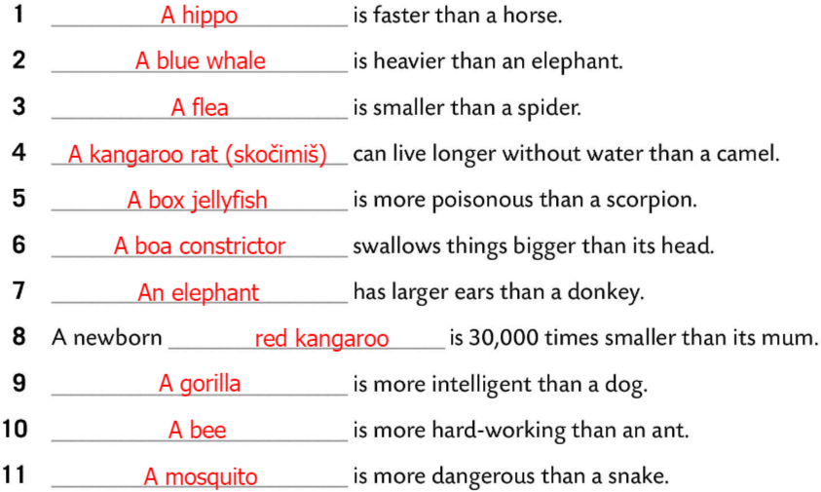
Workbook, page 47.
Find the animal from the box in Task A that fits on the line.
Use each animal only once.
Check.
Check your answers in Task C.
Fill in the table.
Check.

Slide 10
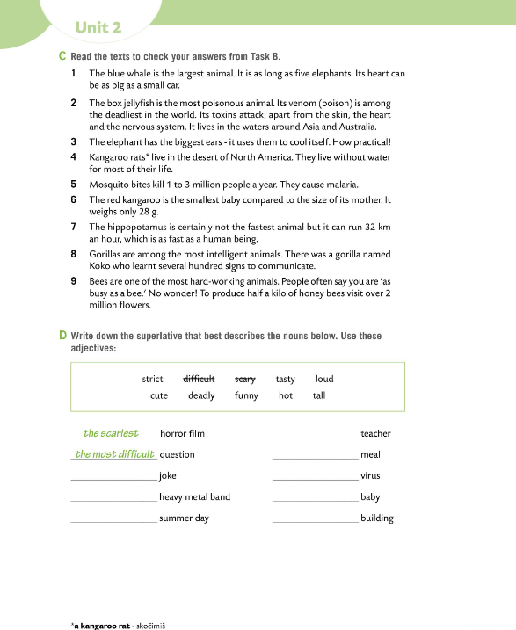
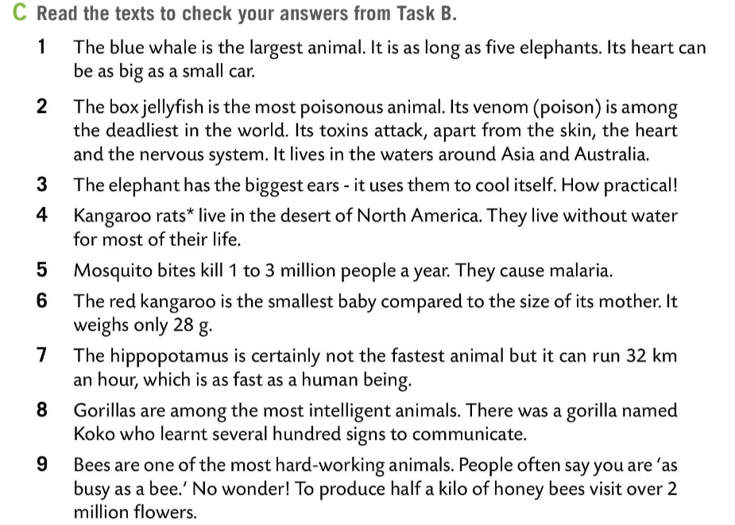
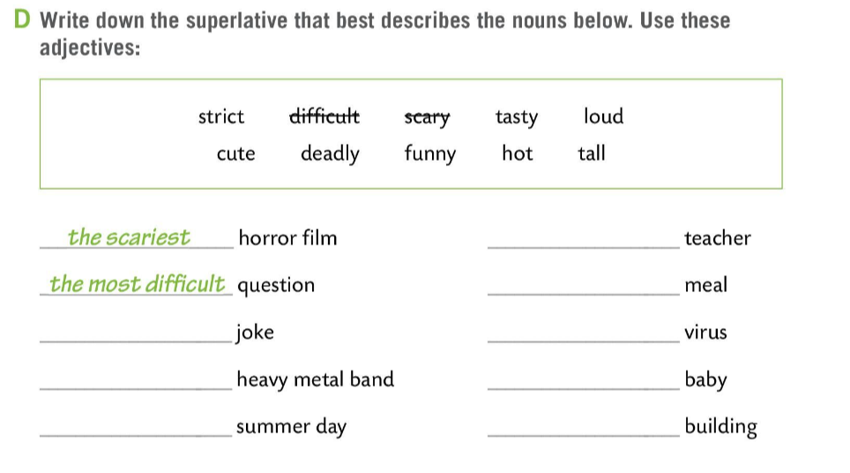
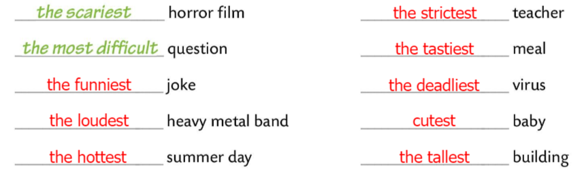
Workbook, page 48.
Read the texts to check your answers from Task B.
Write down the superlative that best describes the nouns below. Use these adjectives:
Check.

Slide 11
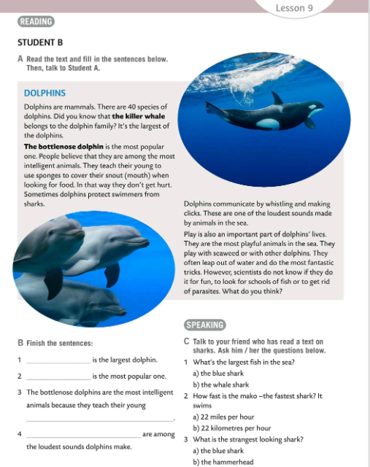
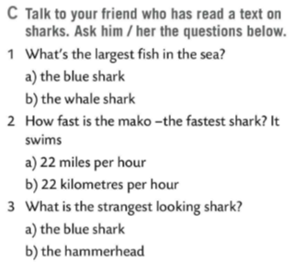
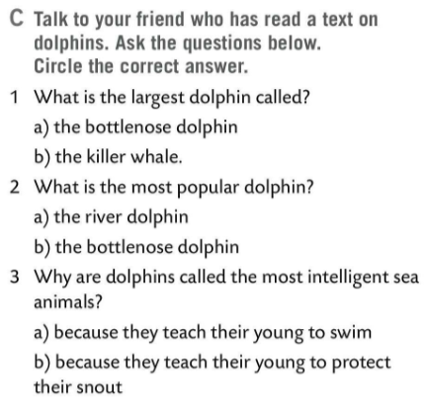

Do Task C. Talk to your friend who has a text on dolphins/sharks.
Ask questions.
Check.
Play the game in 2 groups.
Choose the correct answer.
https://wordwall.net/play/7264/430/467

Slide 12
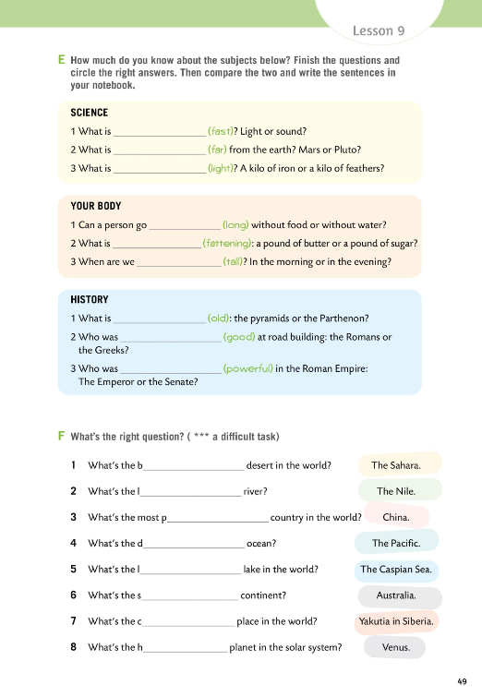
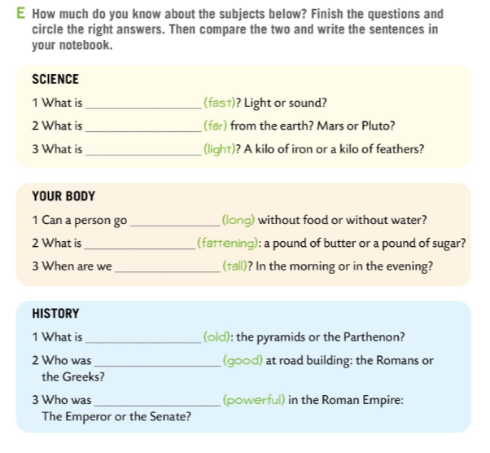
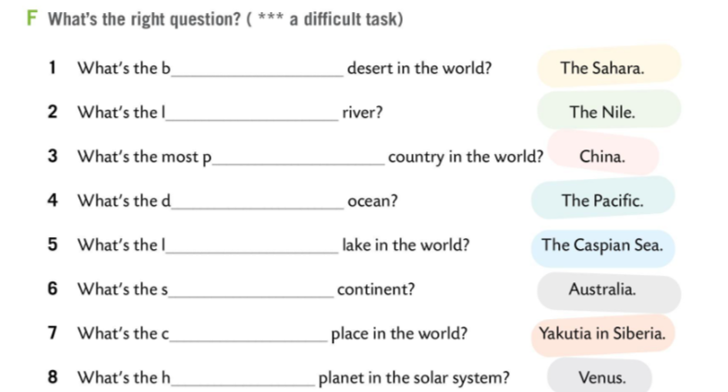
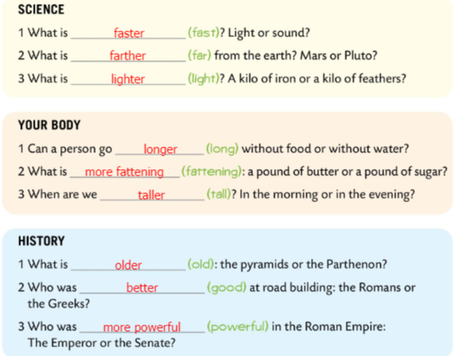
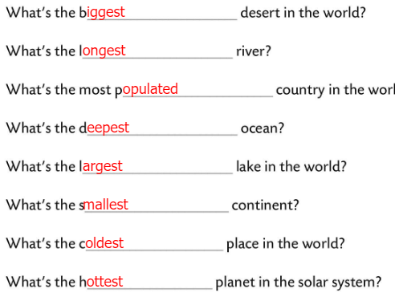
Workbook, page 49.
How much do you know about subjects in Task E?
Finish the questions and circle the right answers.
Then c
Compare the two and write the sentences in your notebook.
Check.
Finish the questions in Task F.
Look at the answers. What do you think the right question is?
Check.

Slide 13
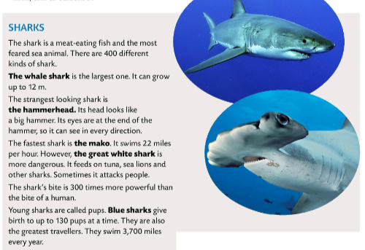
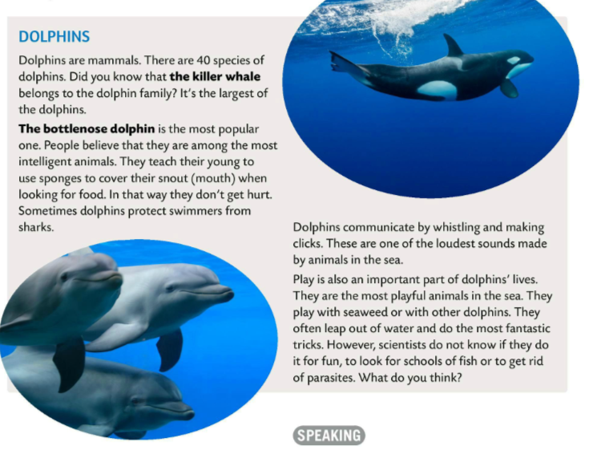
Copy the words in bold.

Slide 14
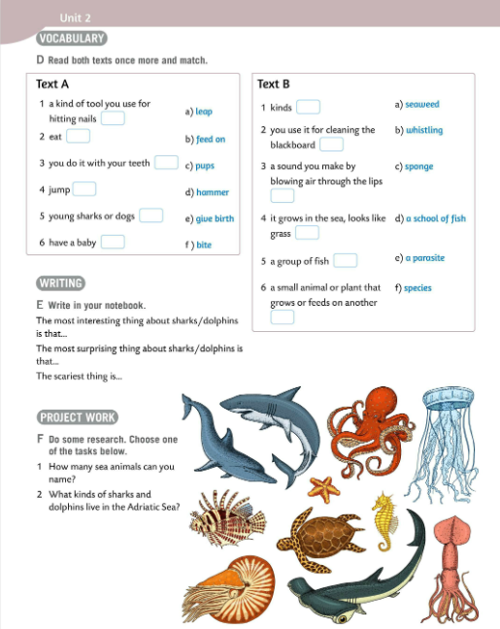
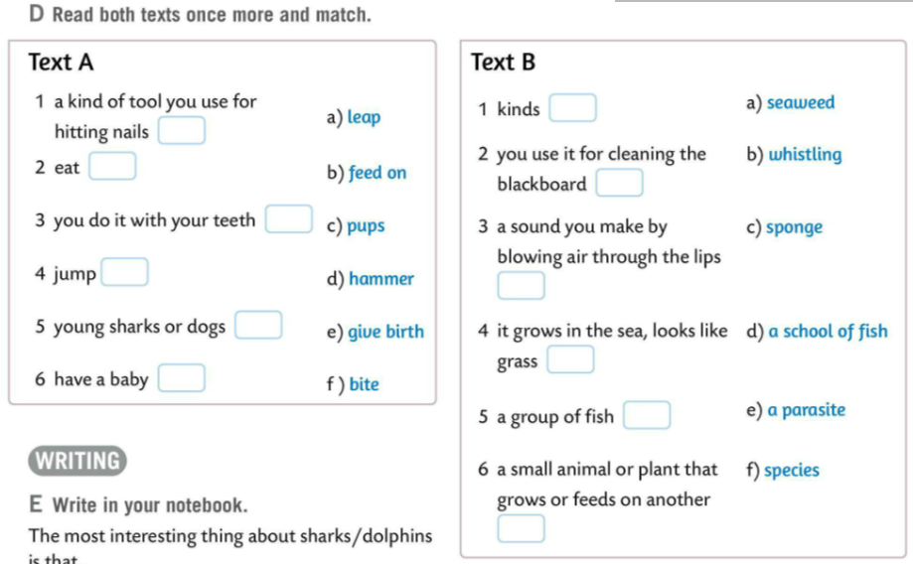
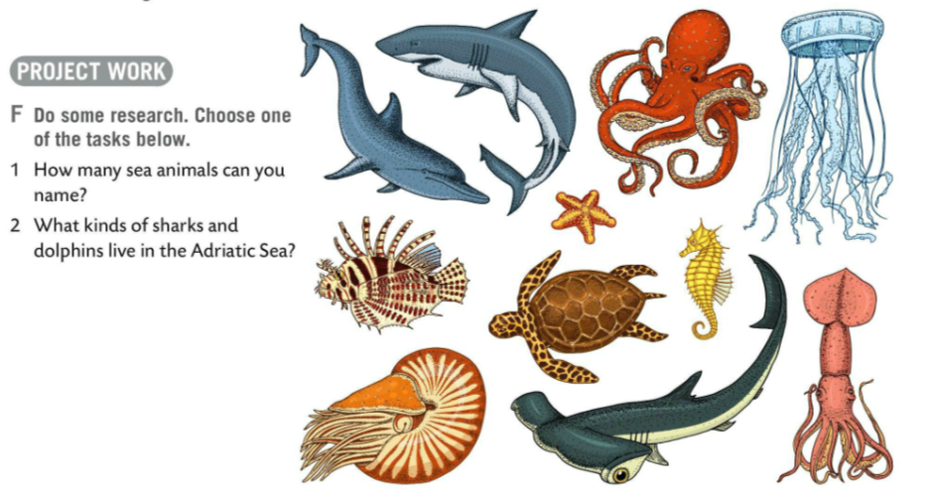
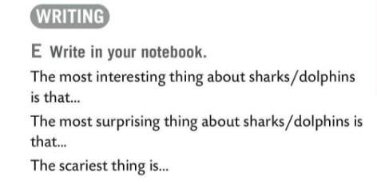
Read both texts again and match words and their explanations.
Check.
Finish the sentences in your notebooks.
1 The most interesting thing about sharks/dolphins is that…
2 The most surprising thing about sharks/dolphins is that…
3 The scariest thing is…
f)
d)
b)
c)
f)
a)
b)
c)
e)
a)
d)
e)
Do research and answer questions from Task F. Make a poster.
Present it to the class.

Slide 15
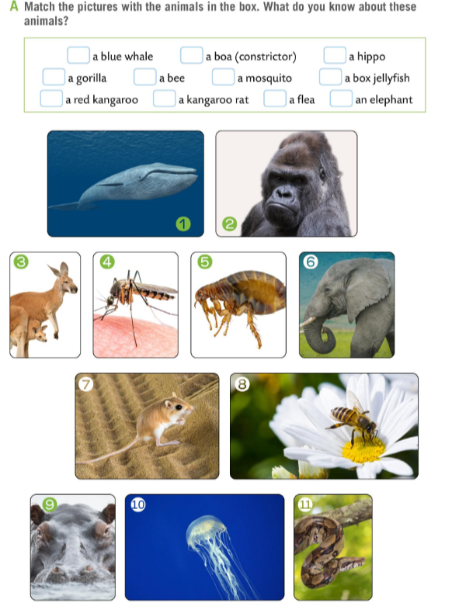
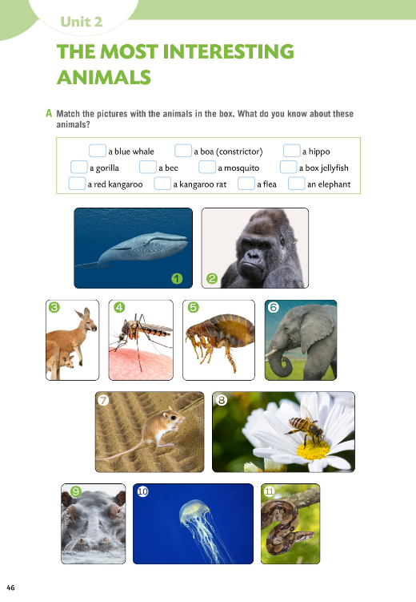

Workbook, page 46.
Match the pictures with the animals in the box. What do you know about these animals?
Check.
Use clues to solve the crossword puzzle.
https://wordwall.net/play/511/066/456

Slide 16
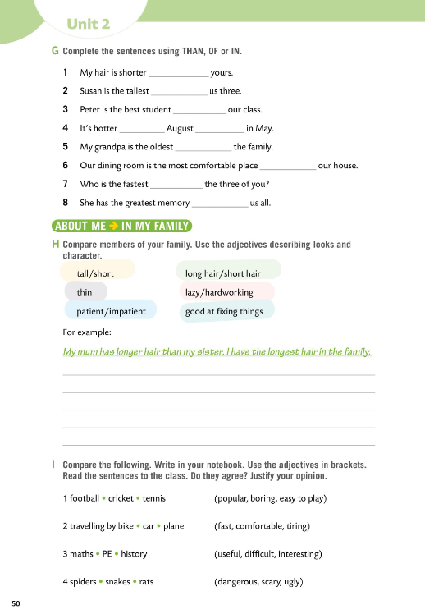
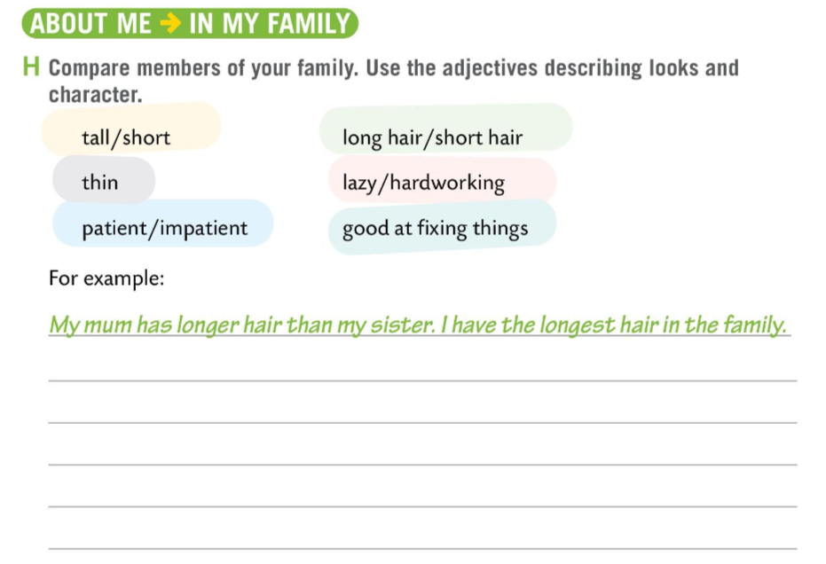
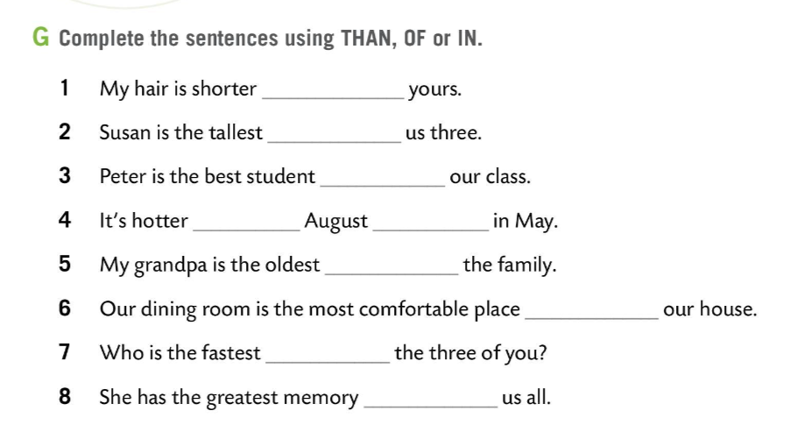
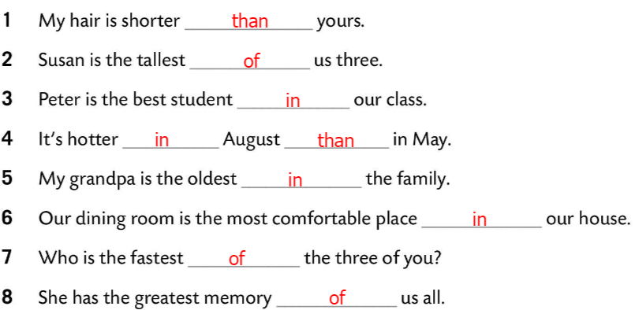
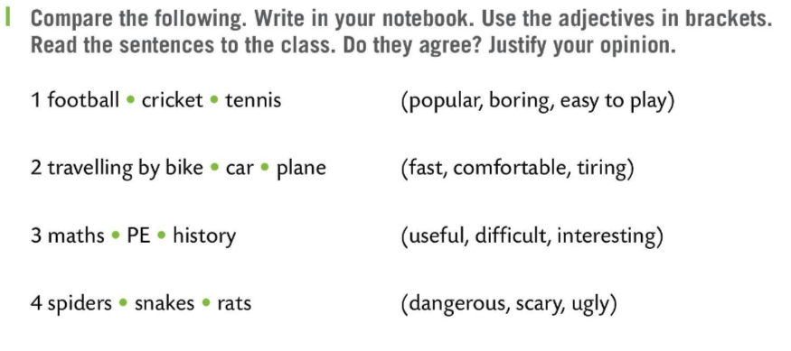
Workbook, page 50.
Complete the sentences in Task G using THAN, OF or In.
Check.
Compare the members of your family.
Use the adjectives describing looks and character.
Share your answers with the class.
Make comparisons in Task I. Write in your notebook.
Use the adjectives in the brackets.
Read the sentences to the class.
Do they agree? Justify your opinion.

